Slide 1

Predicting Taxi Trip Duration
A real-time, deployment-safe regression engine for NYC Yellow Taxi ETA estimation at the exact moment of request.

Slide 2
Problem Statement & Scope
Aligning predictive machine learning with business value and operational constraints.

Slide 3



Business Drivers & User Impact
Core Business Objective
Asymmetric Cost Matrix
Deliver an accurate estimated time of arrival (ETA) to passenger apps prior to trip confirmation. Precise predictions minimize ride cancellations, improve fleet dispatching efficiency, and maximize driver utilization.
Underpredicting duration breaks rider trust and leads to missed appointments. Overpredicting leads to booking drop-offs as riders perceive the service as overly slow. The loss function must account for these non-symmetric operational risks.

Slide 4

Dataset & Quality Standards
Rigorous Data Audit Pipeline
1.2M+
Using 6 months of NYC TLC Yellow Taxi records (Jan–Jun 2023), we implemented strict filtering rules to maintain high data integrity:
Removed null pickup timestamps and unmapped taxi zones.
Filtered out zero/negative trip durations and GPS anomalies.
Filtered NYC Taxi Records
Excluded near-certain cancellations (< 1 min) and extreme outliers (> 180 min).

Slide 5
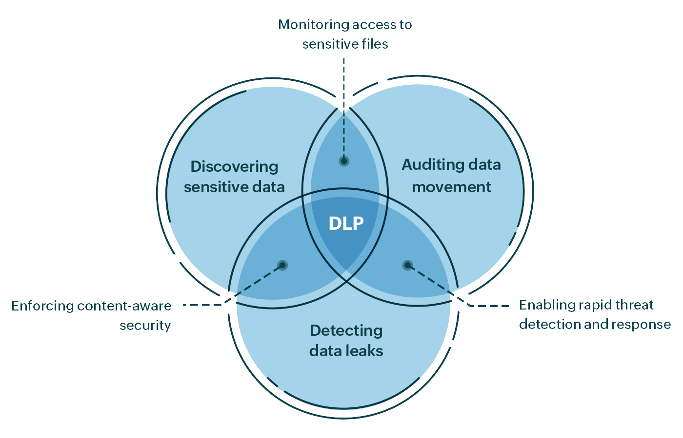
Data Leakage Prevention Audit
Known at Booking: Pickup/Dropoff Zone IDs, request timestamp, day of week, scheduled hour, passenger count.
Post-Trip Data: Meter fare, dropoff timestamp, actual route trajectory, toll amount, tip amount.
Historical Aggregates: Historic hourly zone traffic speed, spatial Haversine distance between zone centroids.

Slide 6









Feature Engineering Pipeline
Temporal Dynamics
Spatial Distance
Zone Aggregates
Cyclical encoding (sine/cosine transforms) of pickup hour and day of week. Captures rush hour peaks and weekend night patterns without artificial boundary discontinuities.
Haversine distance and Manhattan distance computed between TLC pickup and dropoff zone centroids, serving as a primary linear baseline proxy for trip extent.
Target-encoded historical congestion index per location pair, updated on rolling window basis to reflect real-time traffic speeds without future leakage.

Slide 7




Validation & Modeling Workflow
2. Linear Baselines
4. Optimization
Benchmark mean predictor, Ridge, and Lasso regression models.
Tune hyperparameters focusing on Mean Absolute Error (MAE).
1. Temporal Split
3. Tree Ensembles
Train on Jan–Apr, validate on May, test on Jun to mirror real-time prediction.
Train LightGBM and XGBoost models on log-transformed targets.

Slide 8
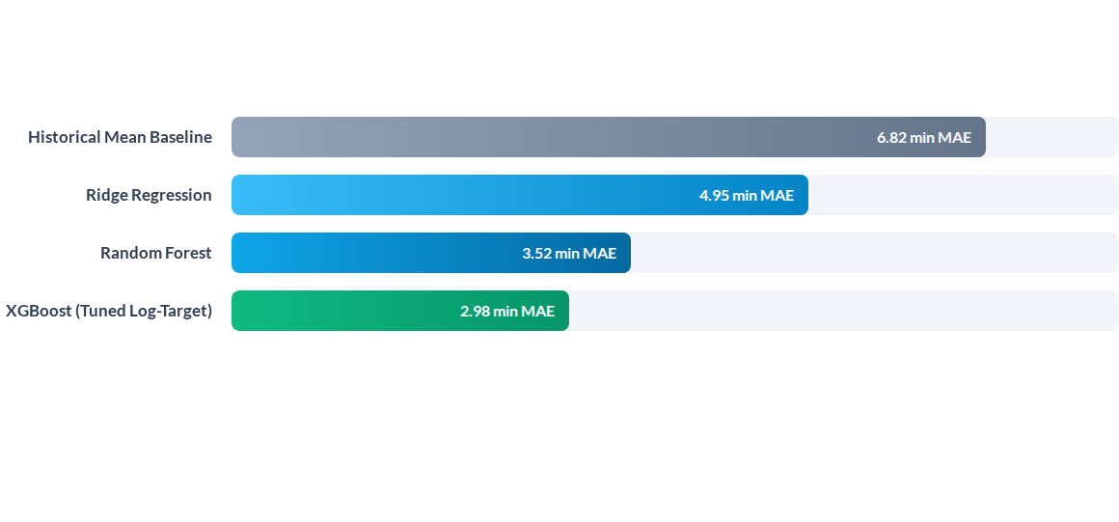
Model Benchmarks & Metrics

Slide 9
Feature Importance & SHAP Drivers
Primary Predictive Factors
Temporal Interaction
SHAP analysis confirms that centroid distance and historical zone speed dominate feature attribution. Dropoff zone location exhibits higher variance influence than pickup zone during peak evening hours.
Pickup hour acts as a critical non-linear multiplier on spatial distance. Distance gains 2.4x higher weight during morning rush hours (7-9 AM) compared to late-night trips.

Slide 10
Performance Across Distance Tiers
Distance Tier | Avg Duration | XGBoost MAE | Baseline MAE | Error Reduction
Short (< 2 miles) | 8.4 min | 1.45 min | 3.80 min | 61.8%
Medium (2–5 miles) | 16.2 min | 2.80 min | 6.10 min | 54.1%
Long (5–10 miles) | 29.5 min | 4.35 min | 9.80 min | 55.6%
Airport / Far (> 10 mi) | 48.1 min | 5.90 min | 14.20 min | 58.5%

Slide 11

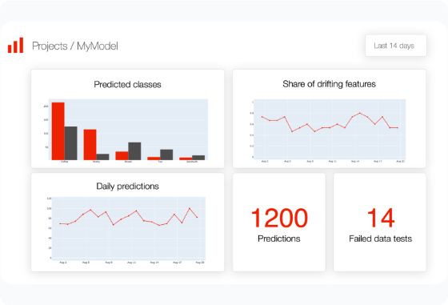
Production Deployment Architecture
Low-Latency REST API: Containerized ONNX runtime deployed via FastAPI handles peak loads exceeding 2,500 req/sec.
Sub-20ms Inference: Pre-calculated spatial lookups in Redis enable sub-20 millisecond p99 response times.
Drift Monitoring: Continuous monitoring of input feature distribution (KS-test) and daily MAE tracking.
Graceful Fallback: Automatic failover to historical zone-pair median lookup if feature service fails.

Slide 12

Questions & Discussion
Predicting Taxi Trip Duration at the Moment of Request

